Slide 1
Project Luther
Dara Elass
September 19th, 2014

Slide 2


The Client
Goal:
Opening Weekend Domestic Gross

Slide 3



The Factors

Slide 4
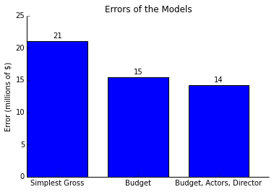
Errors of Models

Slide 5
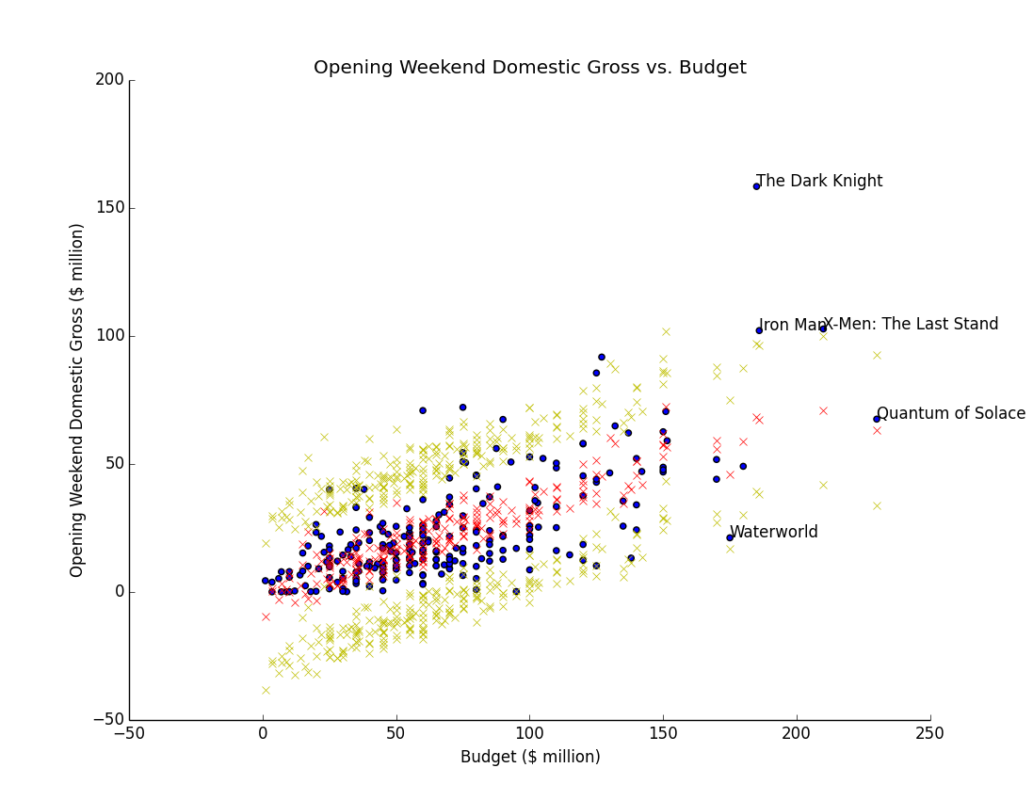
Results: Budget

Slide 6
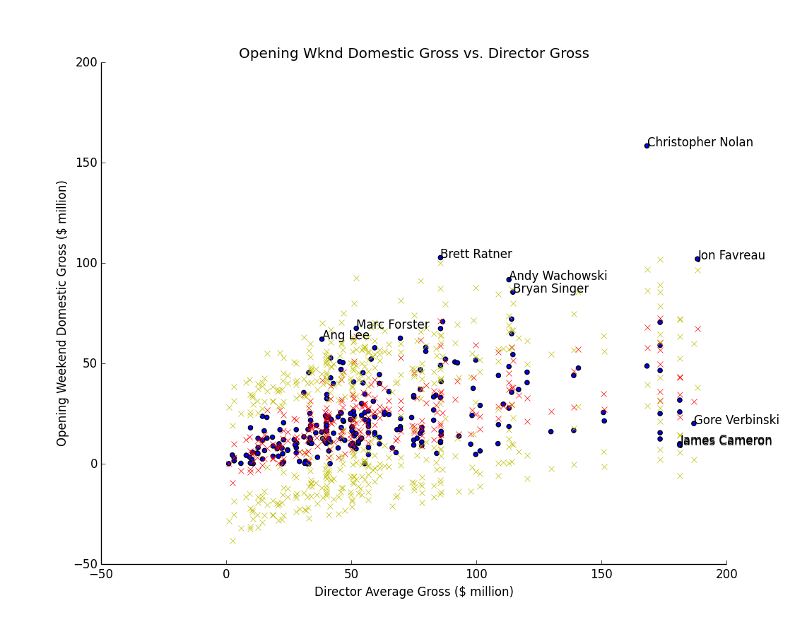
Results: Director Gross (Director)

Slide 7
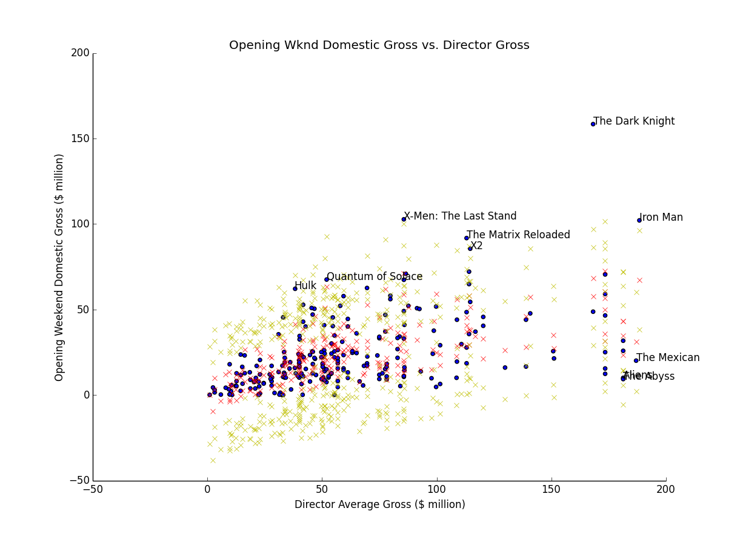
Results: Director Gross (Movie)

Slide 8
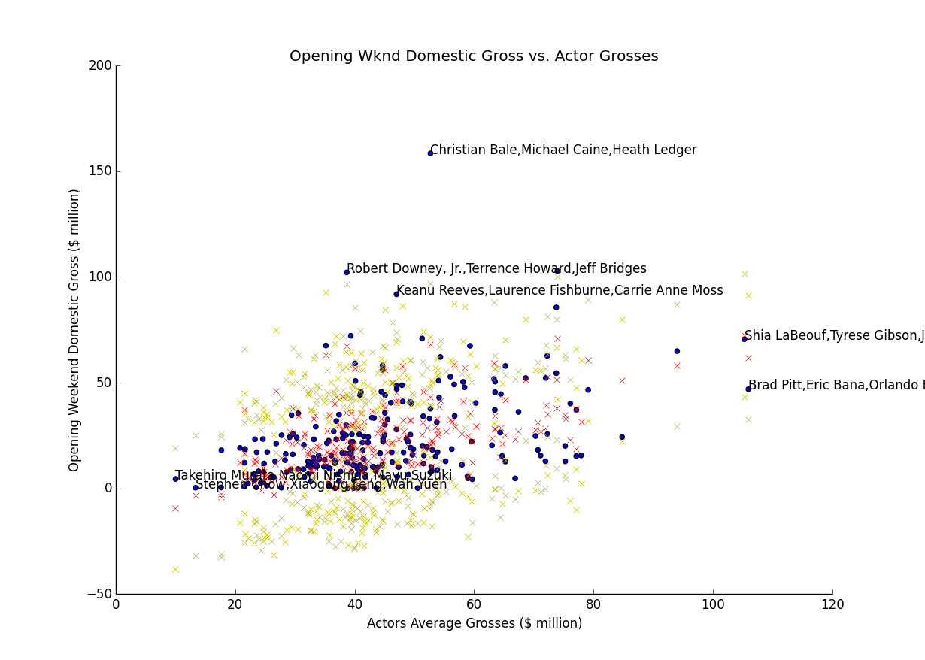
Results: Actor Grosses (Actors)

Slide 9
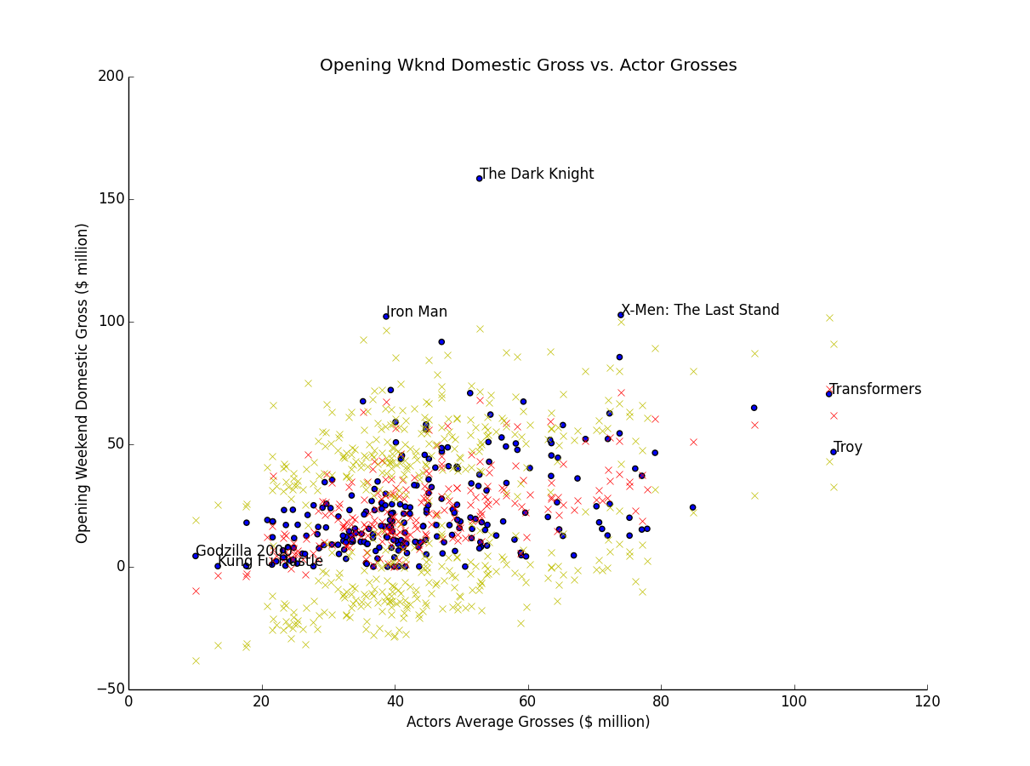
Results: Actor Grosses (Movie)

Slide 10
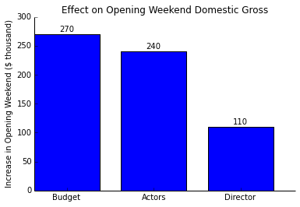
Effects of Factors

